Slide 1
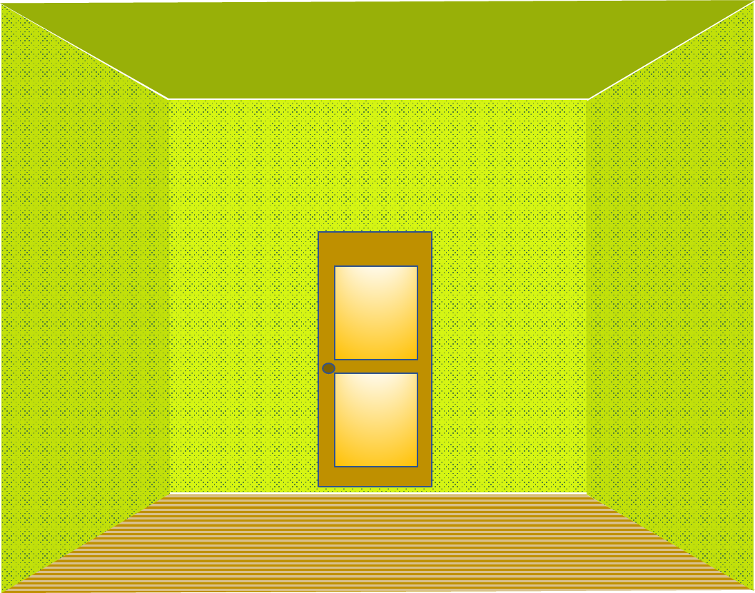

Roof

Slide 2
Floor

Slide 3
Wall

Slide 4
Door

Slide 5
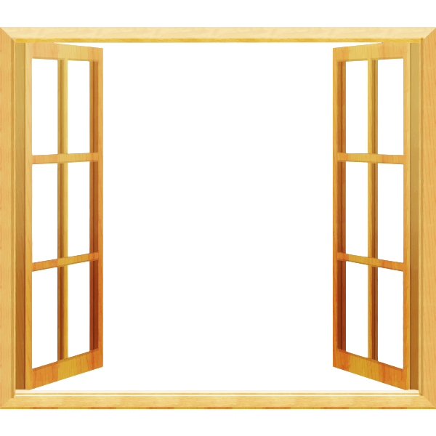
Window

Slide 6

Curtain

